Slide 1
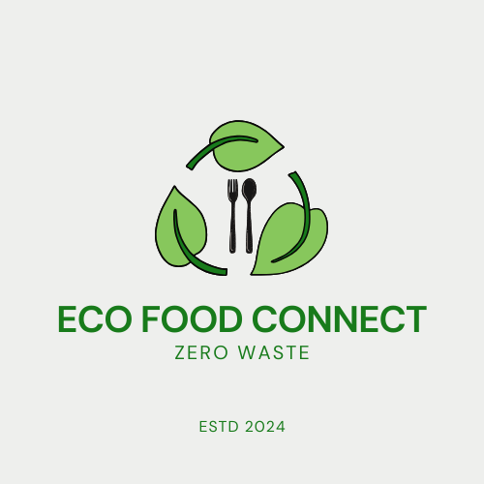


ECO FOOD CONNECT
Bhavya Likhitha Bukka
Tanmay Devraj Pillai
Akshay Raj Chevala

Slide 2
PROBLEM STATEMENT
The United States has a staggering amount of food wastage, with over 133 billion pounds going to waste annually.
This only adds to the already huge problem of climate change through increased greenhouse gas emissions and evidences a disconnected society when millions are hungry each day.
Restaurants are one of the largest generators of surplus food, but they lack a unified platform to efficiently redistribute their excess food to those in need.
That's where the inefficiency in dealing with food waste and hunger is: coordination among restaurants, food banks, logistics providers, and waste management firms.

Slide 3
SOLUTION
EcoFood Connect is an end-to-end online platform that bridges the gap between restaurants, food banks, logistics companies, and waste management firms.
This Java Swing-based software provides an enabling ecosystem for the following activities:
1. Smoothening the process of food donation.
2. Managing the transportation of surplus food.
3. Appropriate disposal of non-edible food waste

Slide 4
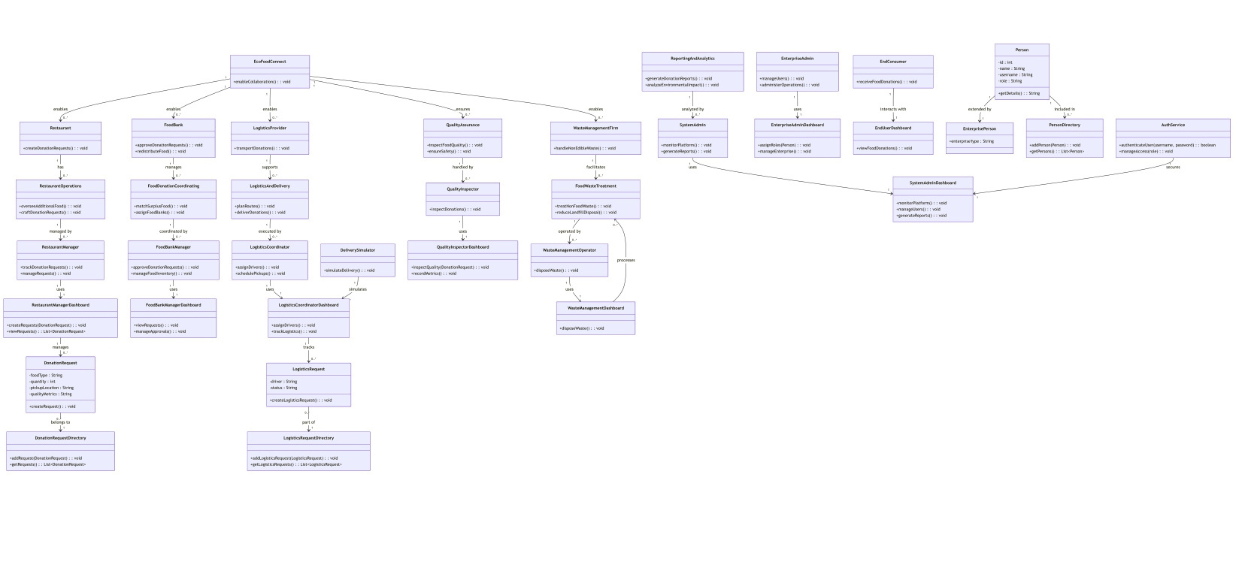
UML DIAGRAM

Slide 5
ADVANCED FEATURES
Centralized Coordination:
Links restaurants, food banks, logistics providers, and waste management firms.
Impact Metrics:
Tracks donations, waste reduction, and carbon emissions.
Role-Based Functionality:
Tailored dashboards and workflows for admins, restaurant managers, logistics coordinators, quality inspectors, and more.
Waste Management Integration:
Sustainable disposal of non-edible food, including composting and energy production.

Slide 6
USE CASE HIGHLIGHT
Example: Food Donation Request Workflow
Restaurant Manager creates a donation request (type, quantity, pickup time).
Food Bank Manager reviews and approves/rejects the request.
Quality Inspector evaluates the food for safety and quality.
Logistics Coordinator assigns a driver and schedules pickup.
Food is delivered, and the request is marked as "Completed."

Slide 7
IMPACT AND VISION
Reduces food waste, feeding the hungry sustainably.
Lowers greenhouse gas emissions and landfill waste.
Empowers collaboration for a positive environmental impact.
Improves operational efficiency for restaurants, food banks, and logistics providers.
Promotes transparency and accountability with trackable metrics on donations, waste, and environmental impact.

Slide 8
THANK YOU

